Slide 1
Quilting Guilt: An Analysis of Quilts, Literacies, and Literacy Practices as Social Justice Reform
Yvonne Kao
ENGL-8600
Seminar Project
November 30, 2018

Slide 2
Background
I am looking for quilting literacies that show up in the quilt artifacts from the show Guns: Loaded Conversations.
I will analyze how these literacies and literacy practices suggest things about quilting literacies and their work in social justice reform.
Studio Art Quilt Associates (SAQA) gives this message:
SAQA is an international non-profit organization dedicated to promoting the art quilt and the artists who create them. We are an information resource on all things artquilt related for our members as well as the public. Founded in 1989 by an initial group of 50 quilters, SAQA members now number more than 3,400 artists, gallery owners, museum curators and corporate sponsors. (“Who We Are.”)
Exigency for Guns: Loaded Conversations Quilt Exhibition:
Today we find ourselves living in a society in which gun violence feels commonplace. Yet an enormous divide exists between people who cherish their heritage of gun ownership and others who are concerned about the rising tide of gun violence.
Artists have been a catalyst for difficult social conversations throughout history. Guns: Loaded Conversations seeks to engage viewers of differing opinions to listen to each other and to encourage community initiatives that may inspire action in seeking solutions. (“Guns: Loaded Conversations”)
One of SAQA’s goals is to “[e]ncourage critical writing, research and publication of articles about art quilts in the art press, popular press and scholarly journals” (“Mission and Goals”).

Slide 3
Artifact Analysis
Artifact Analysis Questions:
What are the major components of this quilt?
What quilting literacies are apparent in this quilt?
What do the literacies/literacy practices suggest about quilting literacies and their work in social justice reform?
How do these quilts work as community-based literacy practice to promote social justice reform?
I chose five quilts as artifacts for this project from the Guns: Loaded Conversations quilt exhibition collection.
I focused specifically on this organization because of its history and promotion of critical thinking and activism.
I thought to analyze each quilt individually and then together as a collection promoting social justice reform.

Slide 4
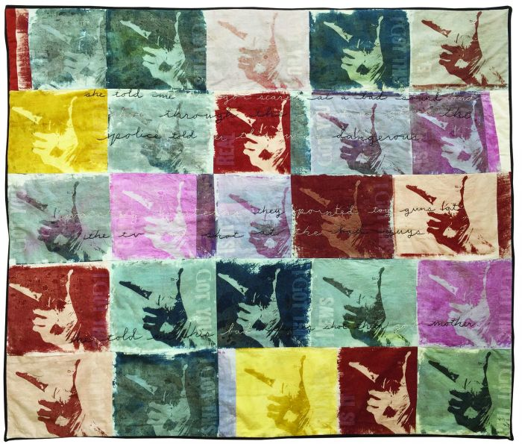
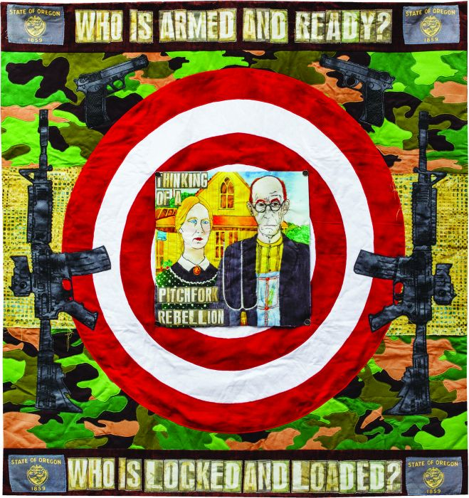
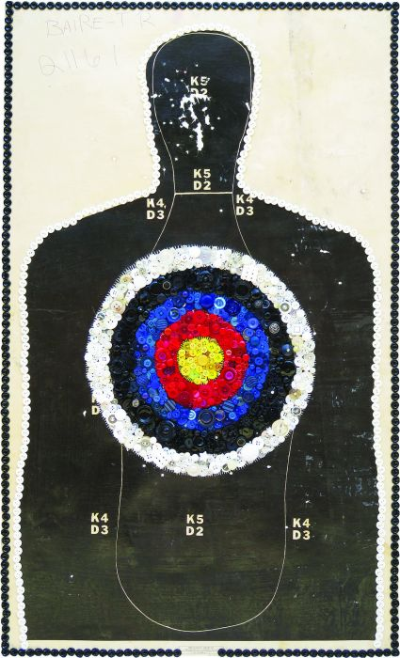
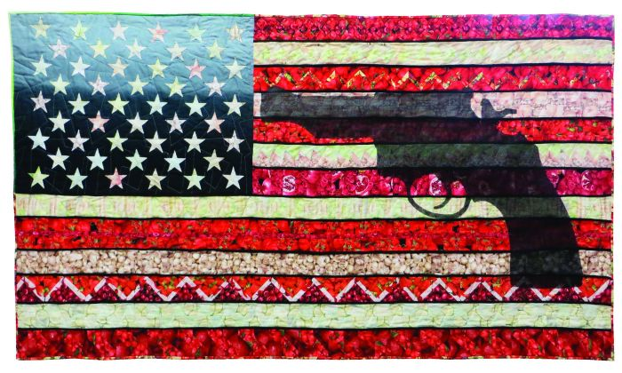
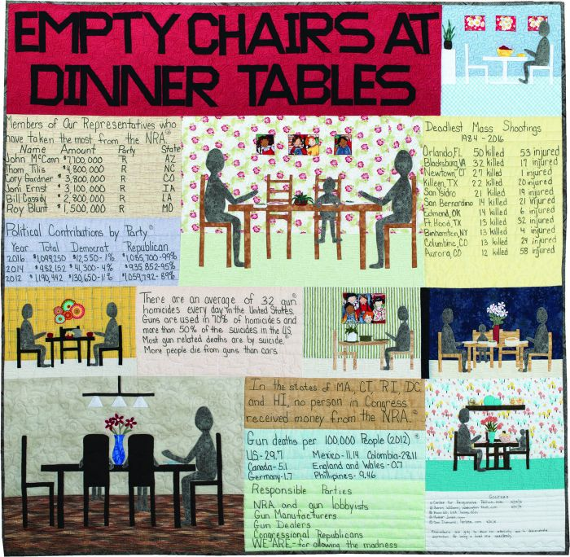
Quilts from the Collection

Slide 5
Quilt #1
Hand Gun
Alisa Golden | Berkeley, California, USA
39 x 45.5 inches
In this piece I captured true gun stories from three disparate views. The conversation opens with hand-embroidered text in black and white and the repeating image of a gun-or is it? Different colors, positive and negative images of my hand, fingers curled, the theme, variations and composition are a nod to Wallace Berman's 1960s Verifax collages. When is it good? When is it bad? Where is the gray? Positive, negative-what colors our judgment? How do we trick ourselves?

Slide 6
Quilt #2
Ma and Pa Get Radicalized in Oregon
Sheryl LeBlanc | Eugene, Oregon, USA
49 x 46 inches
My experience of Oregon practicing a fairly "Live and Let Live" attitude was abruptly shaken by the 41-day occupation of the Malheur National Wildlife Refuge in 2015. I questioned how remote, public access wetlands could possibly morph overnight into a hostile site of gun-wielding, angry protesters. Previous verbal dissatisfaction had escalated into a show of force and an arsenal of guns, where formerly farmers and ranchers had managed to cohabitate in peace.
While the refuge has been restored, my disregard of who is carrying what has not, and I now proceed with caution.

Slide 7
Quilt #3
Ready, Aim, Fire!
Susan Lenz | Columbia, South Carolina, USA
40 x 24 inches
When seeking solutions to any difficult societal conversation, one must be prepared, focused, and forthright. In other words, "Ready, Aim, Fire!“

Slide 8
Quilt #4
America’s Heartland
Michele Makinen | Chicago, Illinois, USA
39 x 72 inches – Photo: Monika Wulfers
The whole concept for this quilt came to me soon after the shootings in Newtown, Connecticut, in December, 2012. The black piping and gray/black behind the stars is intended to create a somber mood, while the appliquéd handgun completes the message.
It is very tragic that gun violence in the United States occurs so often that the message in this quilt has no chance to fade away.

Slide 9
Quilt #5
Empty Chairs at Dinner Tables
Joan Nicholson | Lenexa, Kansas, USA
54 x 55 inches – Photo: Jim Nicholson
When I hear of another death by gun violence, I think of the family of the victim. They will forever live without a loved one because people in the United States have an unhealthy relationship with guns. No more holidays, birthdays, or even everyday dinners without a reminder of their loss. We can do better. Change will only occur if we all force Congress to make reasonable gun laws. At some point, one of us could be the next person staring at an empty chair. I hope it's not you.

Slide 10
Discussion
Where I intend to go with this is something I am still working on, but I know that I want to look for quilting literacies and literacy practices in the artifacts, the quilts, that I have chosen.
I would like to maybe touch on the rhetorical decisions of each quilter, but with the intent of focusing on the literacies and literacy practices that show up in these quilts. I would then analyze what these literacies, primarily quilting literacies, suggest about quilting literacies and their work in social justice reform.
Broadly speaking, I will also look for craft literacies and maybe see where this project takes me in terms of how the arts (not just quilting) can include literacies/literacy practices and work towards social justice reform.
Since this was a community-based organization and a community-based endeavor, I may need to research and analyze the cultural literacies and implications of quilting, as well, specifically American culture, in this case, because that was what the quilt exhibition was localized to, even though SAQA is a worldwide organization.

Slide 11
References
Canady, V. A. (2010). Leaving Gee’s Bend. Multicultural Review, 19(3), 74. Retrieved from http://jproxy.lib.ecu.edu/login?url=http://search.ebscohost.com/login.aspx?direct=true&db=ehh&AN=55853189&site=ehost-live&scope=site (Book Review)
Carey, A. (2015). Patterns: Continuity for Generations of Quilters. Phi Kappa Phi Forum, 95(4), 17–20. Retrieved from http://jproxy.lib.ecu.edu/login?url=http://search.ebscohost.com/login.aspx?direct=true&db=ehh&AN=111560525&site=ehost-live&scope=site
Crum, J. E. (2007). Educating the Art Teacher: Investigating Artistic Endeavors by Student at Home. Art Education, 60(4), 39–44. Retrieved from http://jproxy.lib.ecu.edu/login?url=http://search.ebscohost.com/login.aspx?direct=true&db=ehh&AN=25528890&site=ehost-live&scope=site
GRAHAM, B., & STALKER, J. (2007). Through the Eye of a Needle: The Story of Two Academics’ Use of Fabric Crafts to Make Defiant Messages. Waikato Journal of Education, 13, 33–48. Retrieved from http://jproxy.lib.ecu.edu/login?url=http://search.ebscohost.com/login.aspx?direct=true&db=ehh&AN=33979636&site=ehost-live&scope=site
Hedges, E. (2014). Quilts and Women’s Culture. Radical Teacher, 100, 10–14. https://doi.org/10.5195/rt.2014.148
KUTHY, D., & BROADWATER, K. (2014). Sortings, Cutaways, and Bindings: Quilt-Making as Arts-Based Practice for Social Justice Teaching. (cover story). Art Education, 67(4), 27–33. Retrieved from http://jproxy.lib.ecu.edu/login?url=http://search.ebscohost.com/login.aspx?direct=true&db=ehh&AN=96719796&site=ehost-live&scope=site
LAWTON, P. H. (2010). Hand-in Hand, Building Community on Common Ground. Art Education, 63(6), 6–12. Retrieved from http://jproxy.lib.ecu.edu/login?url=http://search.ebscohost.com/login.aspx?direct=true&db=ehh&AN=54994904&site=ehost-live&scope=site
MITCHELL, R., WHITIN, P., & WHITIN, D. (2012). Interdisciplinary Invitations: Exploring Gee’s Bend Quilts. Art Education, 65(1), 25–32. Retrieved from http://jproxy.lib.ecu.edu/login?url=http://search.ebscohost.com/login.aspx?direct=true&db=ehh&AN=69979297&site=ehost-live&scope=site
Provenzo Jr., E. F. (2004). Time Exposure. Educational Studies, 35(3), 299–300. Retrieved from http://jproxy.lib.ecu.edu/login?url=http://search.ebscohost.com/login.aspx?direct=true&db=ehh&AN=13907390&site=ehost-live&scope=site
Vaughan, M., & Howard, E. (2015). F is for Friendship: A Quilt Alphabet. Social Studies Research & Practice (Board of Trustees of the University of Alabama), 10(3), 145–149. Retrieved from http://jproxy.lib.ecu.edu/login?url=http://search.ebscohost.com/login.aspx?direct=true&db=ehh&AN=112466741&site=ehost-live&scope=site
Wall, M. C., & Stasz, B. (2010). The Stitches Stayed: Creating Rapport around Women’s Work. Anthropology & Education Quarterly, 41(4), 360–369. https://doi.org/10.1111/j.1548-1492.2010.01097.x
Wattsjohnson, Y. M. (2005). Quilting For Social Change. Teaching Artist Journal, 3(3), 175–183. https://doi.org/10.1207/s1541180xtaj0303pass:[_]5

Slide 12
Questions?

