Slide 1
Literacy in InterAction
literacy practices and
self-efficacy

Slide 2
OBJECTIVES
Define literacy/literacy practices
Identify literacy practices in academic setting
Connect literacy practices and self-efficacy
Discuss heuristic
Raise questions about self-efficacy

Slide 3
What is literacy?
A group of “social practices and conceptions of reading and writing” (Street 430)
Street’s notion based on ideological model, which emphasizes challenge between power and authority and resistance and creativity (434)
Notes:
When broken down further, literacy includes vernacular, functional, digital, etc.

Slide 4
What are literacy practices?
Ways that people make meaning of language in their lives (values, feelings, attitudes, relationships)
Means that are not always observable, but impacted based on interaction and learning
(Edwards 3)
Notes:
Narrowed definition that best describes literacy practices

Slide 5
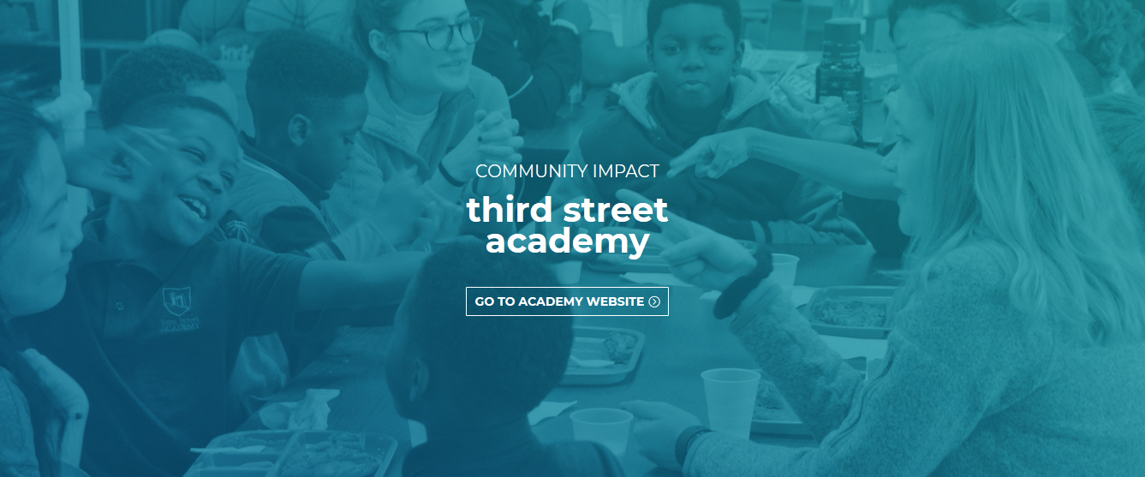
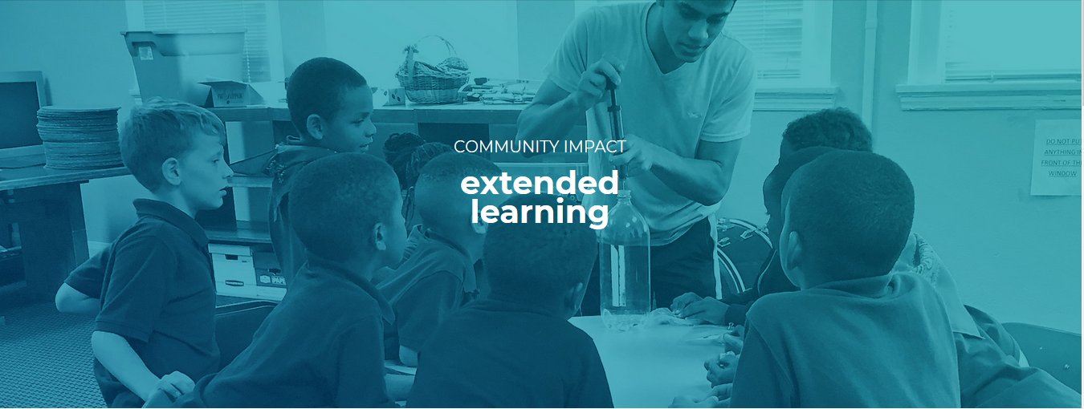
Literacy practices in various settings
Third Street Academy,
private nonprofit faith-based
all-boys’ academy for preK-4 grades
Pictures courtesy of Third Street Education Center
Notes:
Third Street

Slide 6
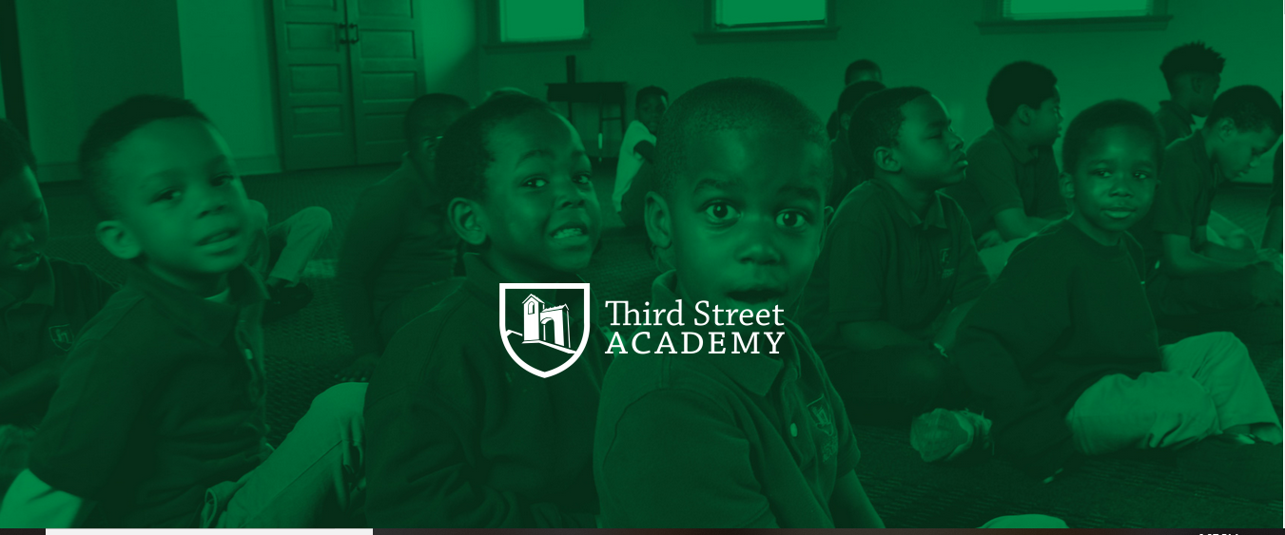
Classroom
Relevant spiritual application
Questioning of selves, peers, staff
Reconceptualization of language
Incorporation of popular culture
Creed of self-affirmation
Picture courtesy of Third Street Education Center
Notes:
I used observations and data analysis from physical documents (stats, performance progress from previous course assignment) and website for this info.
-Parts of speech song that encourages movement (pop flossing dance tied to gaming)
-Lessons learned that help them relate spiritual values to resolving conflict or considering behavior—”would Jesus be pleased”
-Creed

Slide 7
Workplace
Ongoing professional development
Questioning of selves and peers
Use of workplace communication (codeswitching, etc.)
Adoption of professional culture
This Photo by Unknown Author is licensed under CC BY-NC-ND
Notes:
Define professional

Slide 8
Literacy and self-efficacy
This Photo by Unknown Author is licensed under CC BY-SA
Notes:
Define self-efficacy-according to Bandura, “people’s beliefs about their abilities”
How does how one processing and interacting impact beliefs about self?
If adults lack the skills for work or nonacademic environment, they may feel less confident and inadequate

Slide 9
heuristic
Relationship building that affirms adult identity
Possibilities in bridging tensions between power and authority and resistance and creativity
Curriculum that emphasizes familiarity with language to resist standard rules
Consequences of challenging assumptions about literacy (Vai culture)
Notes:
Consider talking about:
Examples from Indigenous communities in the Americas
Examples from around the world

Slide 10
Questions about self-efficacy
How do the Academy’s embracing of these practices impact how students feel about ability to perform?
How can this model benefit adults in nonacademic spaces (writing centers, etc.)

Slide 11
Works cited
Bandura, Albert.”Self-Efficacy.” https://web.stanford.edu/~kcarmel/CC_BehavChange_Course/readings/Bandura_Selfefficacy_1994.htm
Edwards, Martyn. “Literacy Practices: Using the Literacies for Learning in Further Education Framework to Analyse Literacy Practices on a post-compulsory Education and Training Teacher Education Programme,” Sheffield Hallam University Research Archive (SHURA), http://shura.shu.ac.uk/5245/1/edwardsseej.pdf-Journal
Pajares, Frank. “Overview of Social Cognitive Theory and Self-Efficacy” https://www.uky.edu/~eushe2/Pajares/eff.html. Accessed 2 December 2018.
Street, Brian. “The New Literacy Studies.” Literacy: A Critical Sourcebook, edited by Cushman, Ellen, et al., Bedford/St/ Martin’s, 2001. pp. 430-442.
Third Street Education Center. Third Street Academy, 2018, https://thirdstreetec.org/academy/. Accessed 2 December 2018.

