Slide 1
Representations of Black Male Protest: A Google Search
Alicia K. Hatcher, East Carolina University
English 8600—Seminar in Writing Studies & Pedagogy
Dr. William Banks
Twitter: @AKHatcher2020
Email: hatchera17@students.ecu.edu

Slide 2
My Approach Step 1: The Research Question
How do websites represent Black male protest efforts in contemporary American society?
Google search
Used the phrase “Black male protest”

Slide 3
Rationale for Using Google
“As of this past June, Google occupies 68.75 percent of the global search engine pie” (Jerri Collins of Lifewire.com)
According to Google’s Senior Vice President, Amit Singhal, "Google now processes over 40,000 search queries every second on average which translates to over 3.5 billion searches per day and 1.2 trillion searches per year worldwide…” (Jerri Collins of Lifewire.com)
Notes:
My purpose for completing this exploratory work was to see how Google, the search engine used by most people, presents information to us regarding Black men and their protest efforts.

Slide 4
Breakdown (Lifewire.com)
Notes:
My purpose for completing this exploratory work was to see how Google, the search engine used by most people, presents information to us regarding Black men and their protest efforts.

Slide 5
My Approach Step 2: The Data Collection Tool
Category 1
Information about the site (ownership, currency)
Category 2
The sites purpose, audience, and tone
Category 3
The site’s physical characteristics
What is the name of the website?
When was the site last updated?
Who owns the site?
What is the site’s purpose?
Who is the site’s audience?
What is the tone of the site’s content?
What are the aesthetic characteristics of the site?
What types of images are used on the sites?

Slide 6
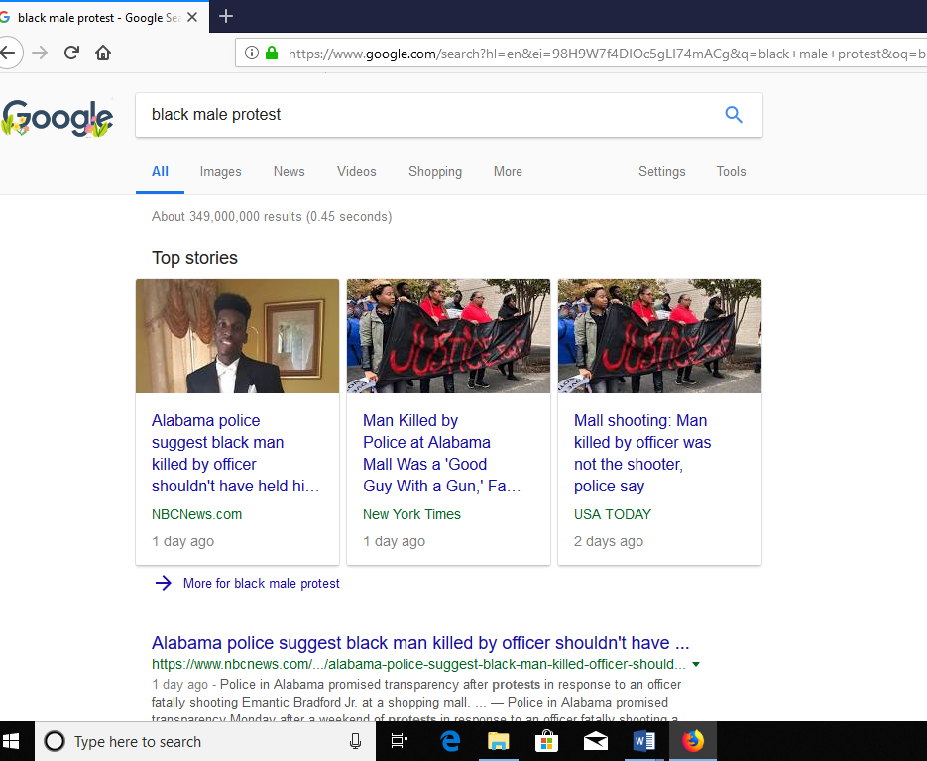
Results Of My Google Search using the phrase Black male protest

Slide 7
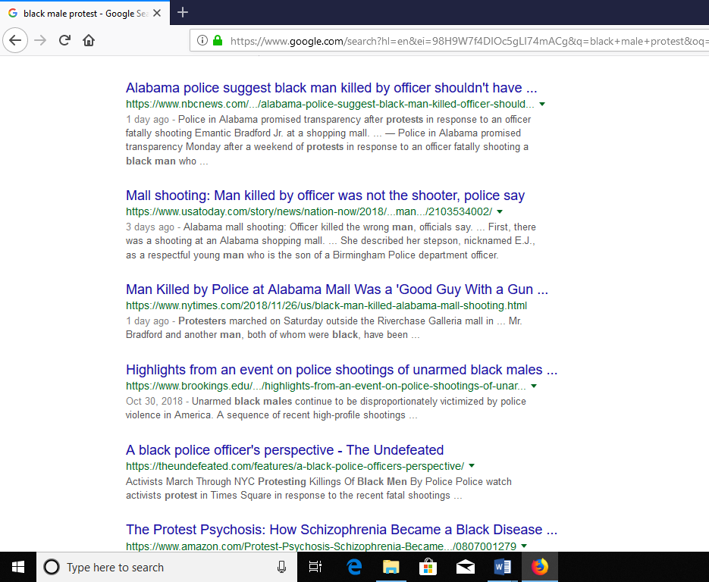
Results Of My Google Search using the phrase Black male protest

Slide 8
Expectations vs Actual Findings
Research Question: How do websites represent Black male protest efforts in contemporary American society?
Notes:
Expectations: The websites would present information about the ways Black men are protesting within our contemporary society. They would include information about protest efforts such as those of Black Lives Matter, Colin Kaepernick and other athletes, and possibly information about the 1968 Olympics.
Actual Findings: They do not represent Black male protest efforts at all. The top 3 results were from mainstream news sources, each of which focused on the killing of an Alabama Black man at a mall.

Slide 9
Implications
Positive—Conversations regarding the killing of Black men are being covered by mainstream media.
Positive—Offers a way to discuss Google searches with my students
Negative—left with questions about Google’s search matrix
Negative—possible problems with my search terms/phrase and website choices?
Should I have included other search terms?
Would the search results have changed if a different search engine was used?
Should I have explored more than 3 of the results?
Notes:
Expectations: The websites would present information about the ways Black men are protesting within our contemporary society. They would include information about protest efforts such as those of Black Lives Matter, Colin Kaepernick and other athletes, and possibly information about the 1968 Olympics.
Actual Findings: They do not represent Black male protest efforts at all. The top 3 results were from mainstream news sources, each of which focused on the killing of an Alabama Black man at a mall.

Slide 10
Additional Contexts
4th result—from The Brookings Institute
5th result—from The Undefeated (According to their “About” section, “The Undefeated is the premier platform for exploring the intersections of race, sports and culture.”)

Slide 11
Wrap Up
What does it mean to be literate in the 21st century?
When literacy moves into digital spaces, how do those new contexts shapes what literacy looks like?

Slide 12
Alicia K. Hatcher, PhD Student East Carolina University Twitter: @AKHatcher2020 Email: hatchera17@students.ecu.edu, akhatcher04@gmail.com

