Slide 1
What would Mickey do?: Disney’s response to tragedy in the community
Emily tucker

Slide 2
Company image
Traditions
Four Keys
Company jargon
Cast member
Onstage/backstage
Roles
Guest (with a capital G)

Slide 3
history
Walt’s letter to shareholders (1940)
Was Walt’s response a reaction of company culture?

Slide 4
September 11, 2001
Disney theme parks evacuated
Internal response
External response

Slide 5
June 2016
Pulse nightclub shooting
June 12, 2016
Alligator incident of Lane Graves
Responses
Memorials

Slide 6
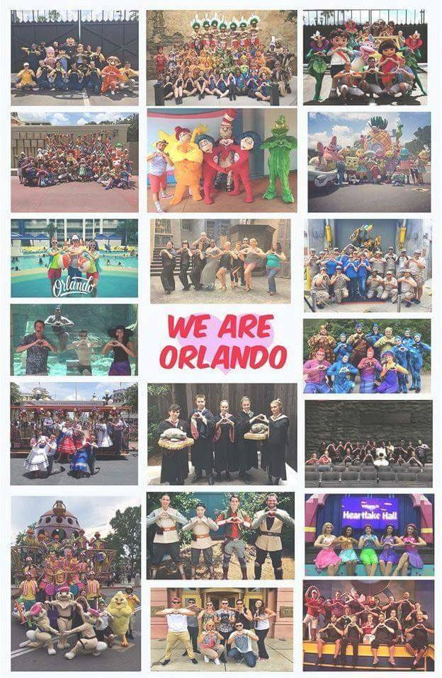

Slide 8
Frameworks + analysis
Jenkins’s “participatory culture”

